Slide 1
Brazil

Slide 2
History of Brazil
-Treaty of Tordesillas: a treaty between Spain and Portugal in 1494 that gave Portugal control over what is present-day Brazil

Slide 3
History of Brazil
-Main source of income for colonists: sugar plantations
-As native tribes were conquered, colonists enslaved them to work in the sugar plantations
-When native slaves died from diseases brought by colonists, African slaves were brought to Brazil to replace them

Slide 4
History of Brazil
-Brazilians today: a mix of European, Native, and African ancestry
-Brazil was a Portuguese colony from 1500-1822
-Independence was granted in 1822

Slide 5
Economy of Brazil
-Prominent natural resources: iron, petroleum, and ethanol (fuel created from sugar cane)
-Major producer of hydroelectricity
-Powered by over 1,000 rivers (including the Amazon)

Slide 6
Culture of Brazil
-When colonists arrived in early 1500s, native people in Brazil numbered between 1 million to 5 million
-Today, only about 200,000 remain in the depths of the Amazon rainforest

Slide 7
Culture of Brazil
-Large numbers of immigrants from Germany, Italy, and Spain live in Brazil
-Brazil has the largest population of Japanese people outside of Japan
-Portuguese colonists brought the Portuguese language as well as Catholicism
-Brazil has the largest Catholic population in the world

Slide 8
Culture of Brazil
-Carnival: an important feast day in Brazil
-Held from the Friday to Tuesday before Ash Wednesday
-samba: a Brazilian dance with African influences
-Main dance that is featured during carnival

Slide 9
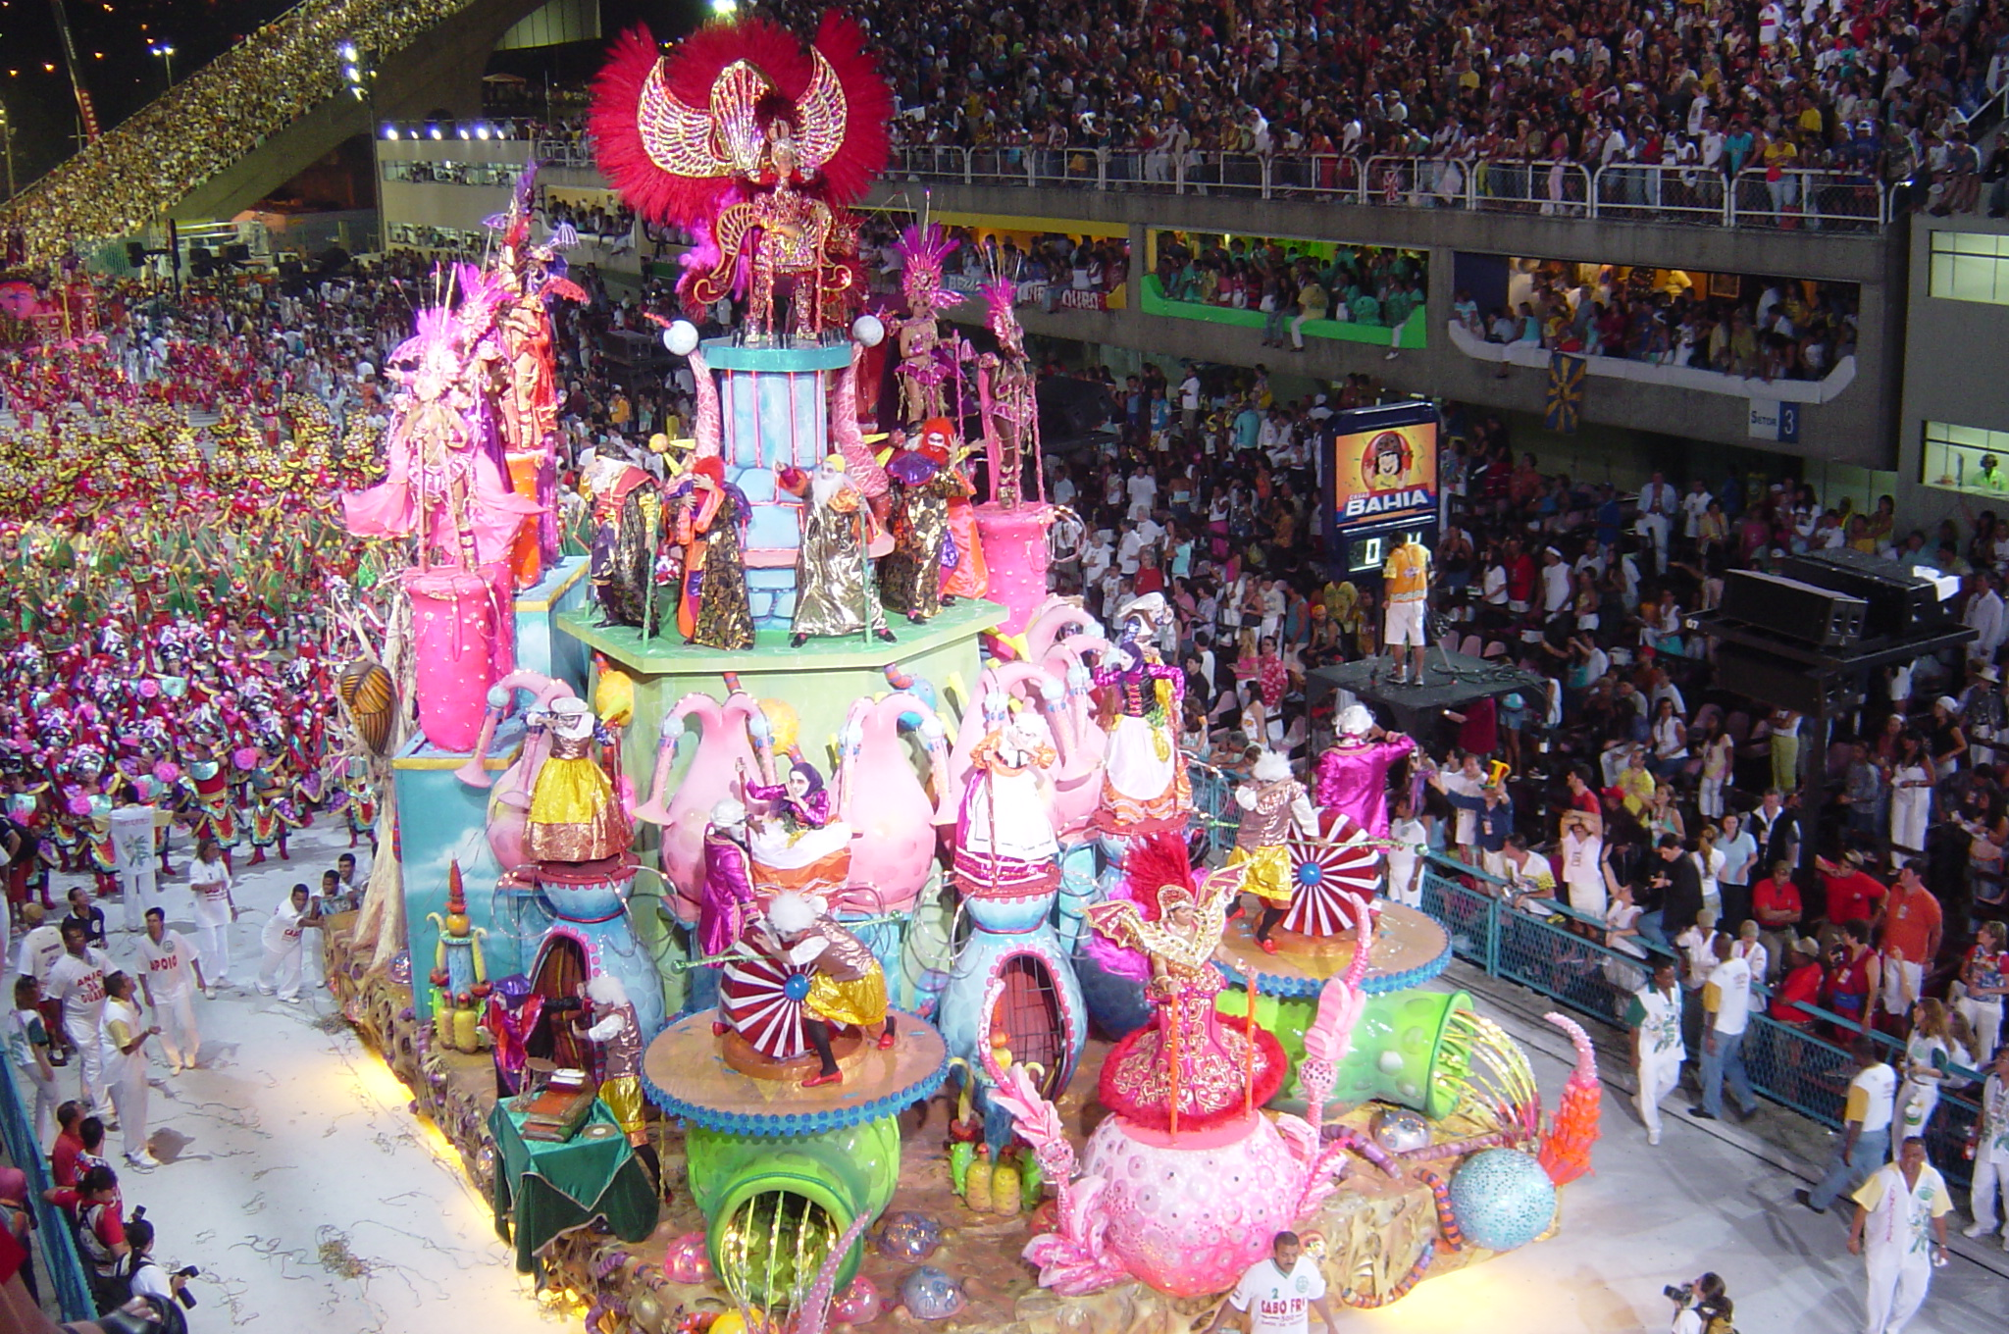

Slide 10
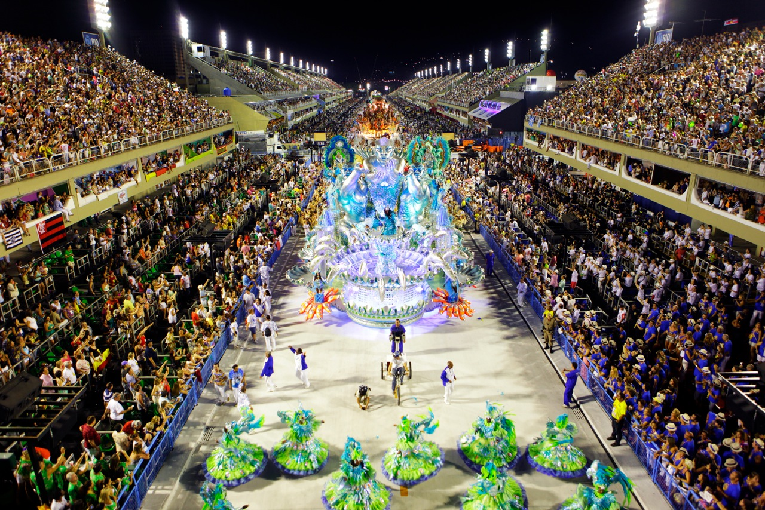

Slide 11
Culture of Brazil
-capoeira: a mix of martial arts and dance
-Slaves from Angola brought this dance with them from Western Africa
-favelas: slums that feature small houses/apartments, poor sanitation
-Over 600 favelas in Rio de Janeiro alone

Slide 13
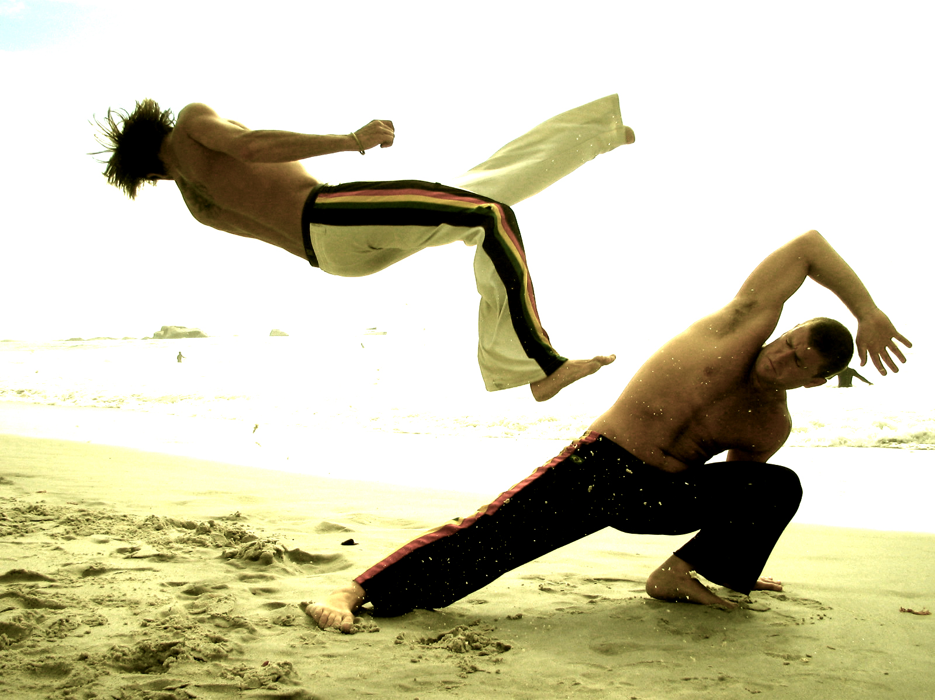

Slide 14
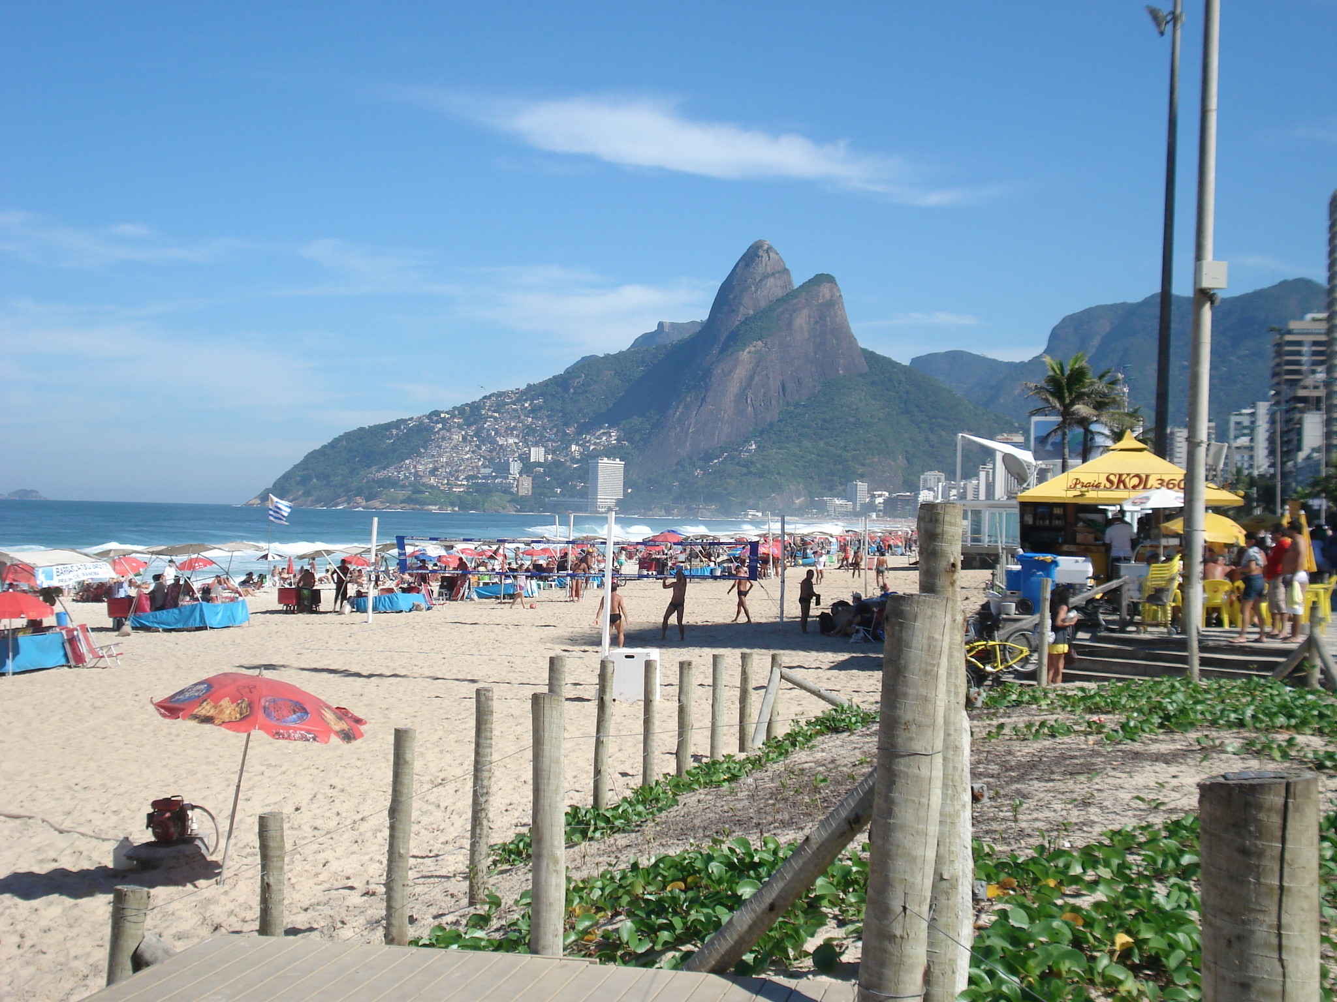

Slide 15
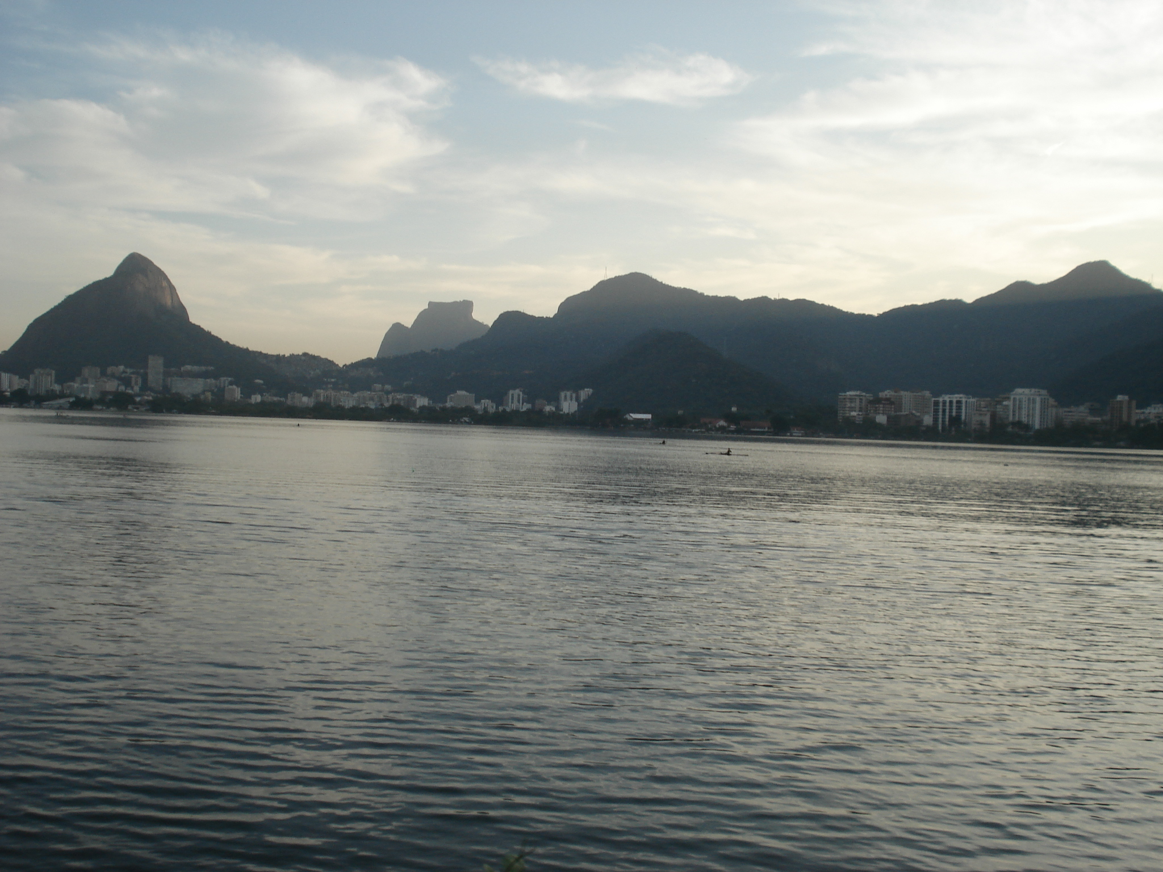

Slide 16
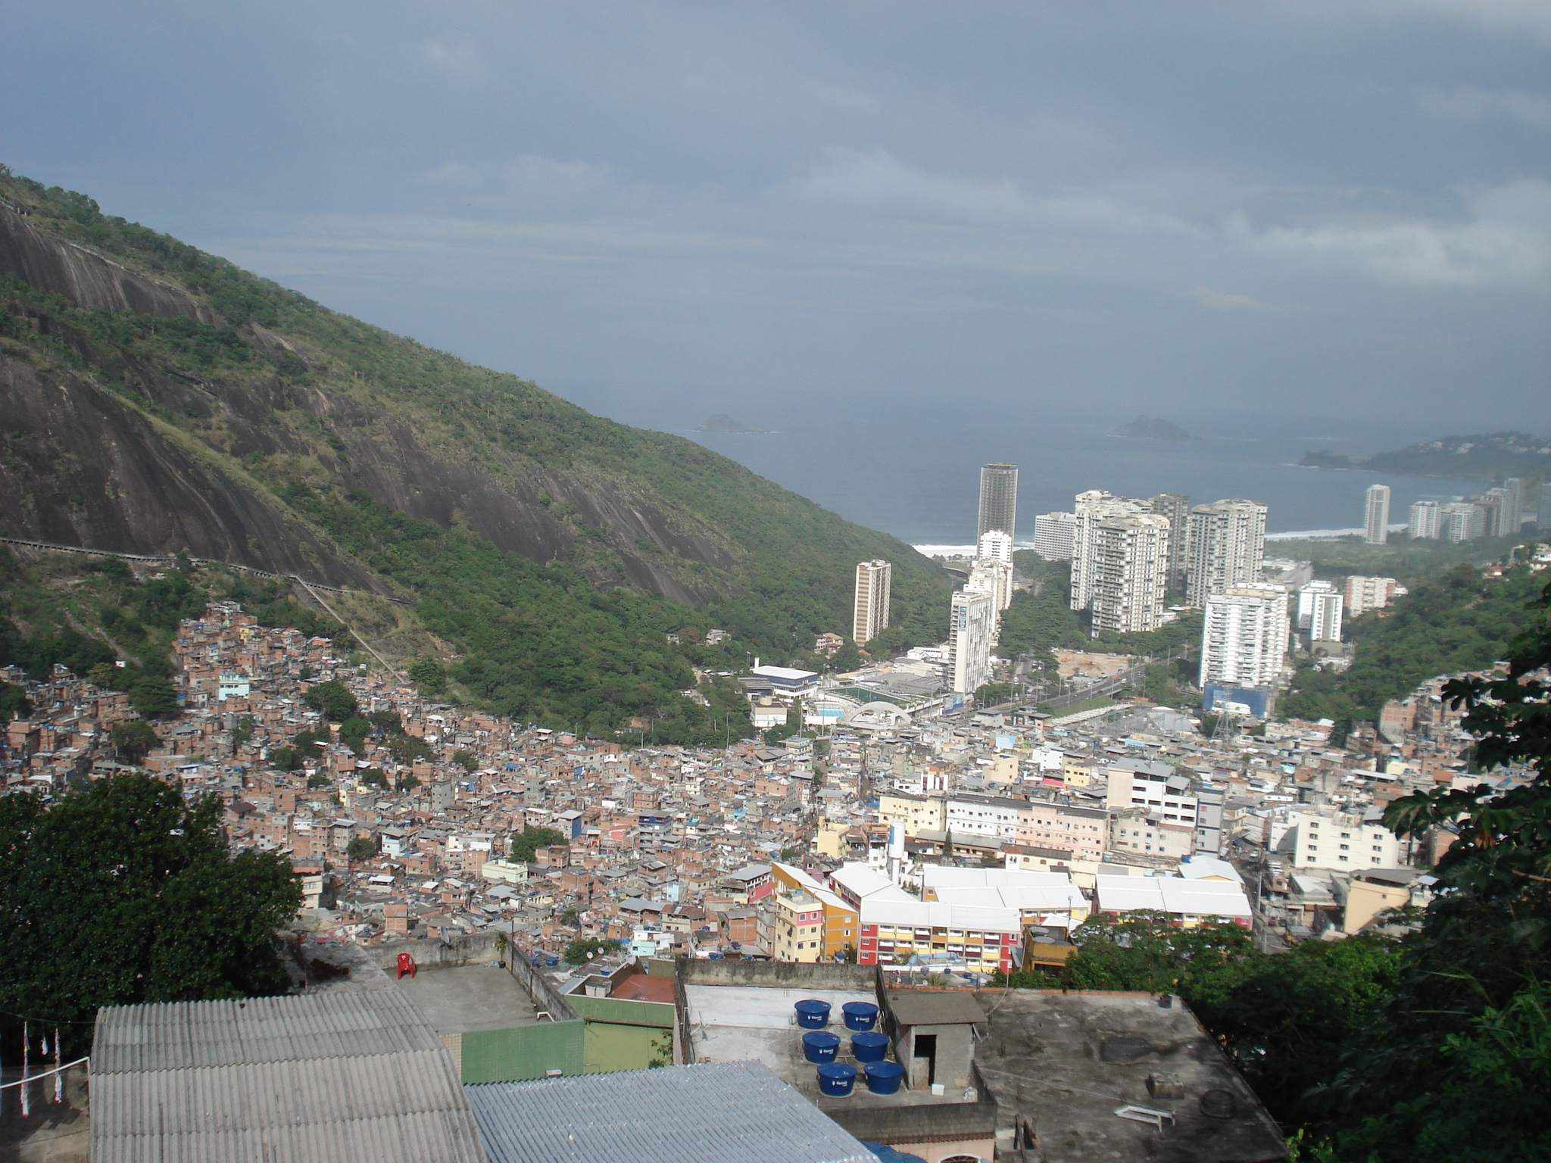

Slide 17
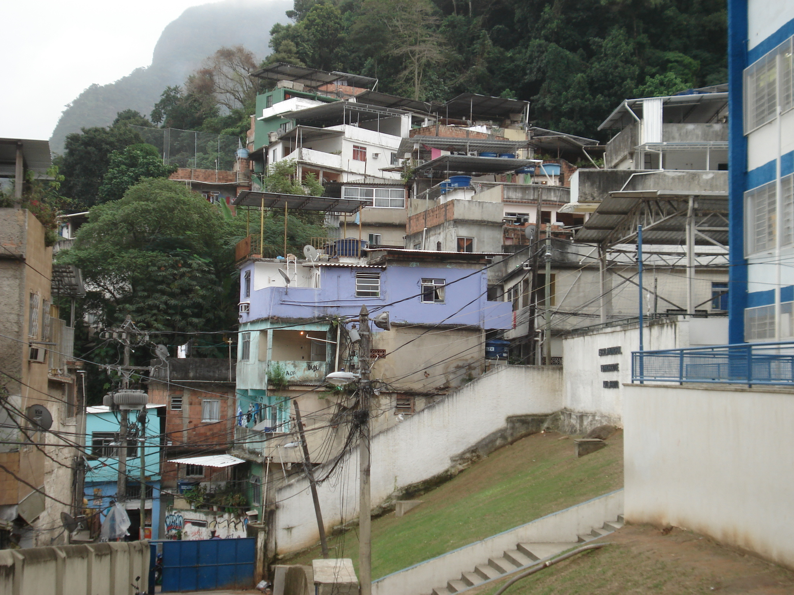

Slide 18
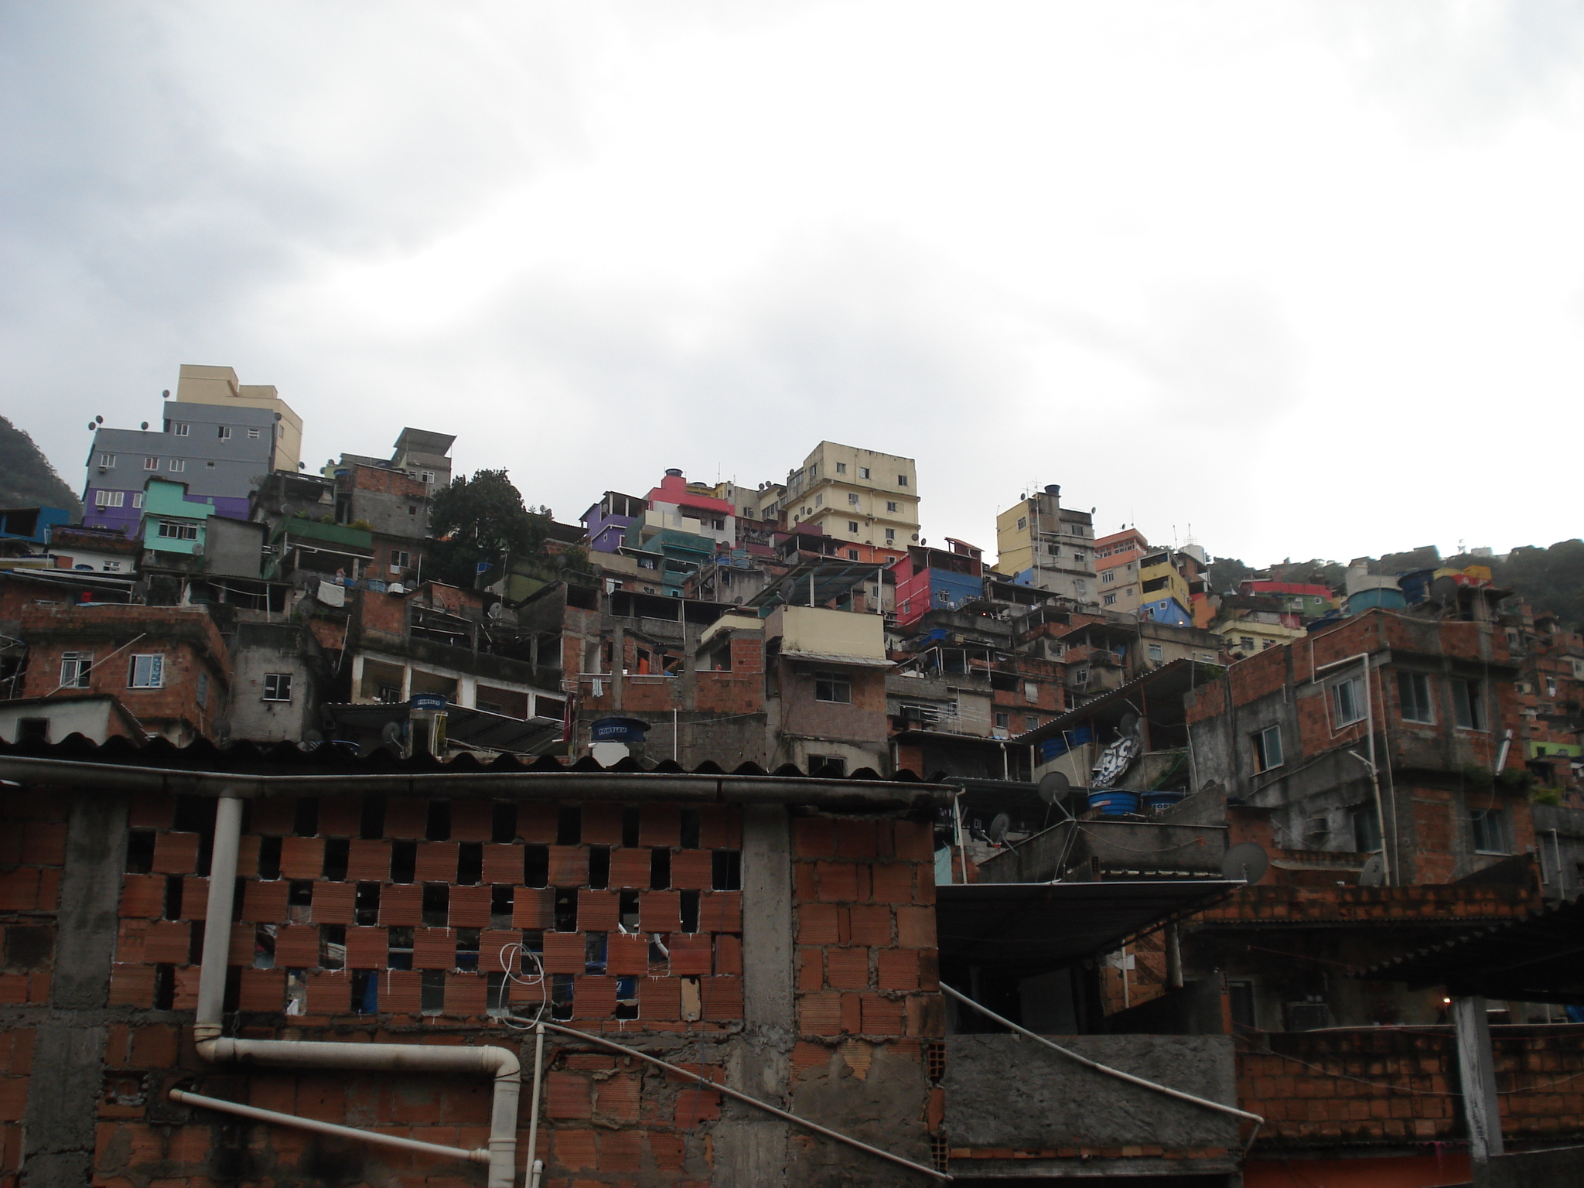

Slide 19
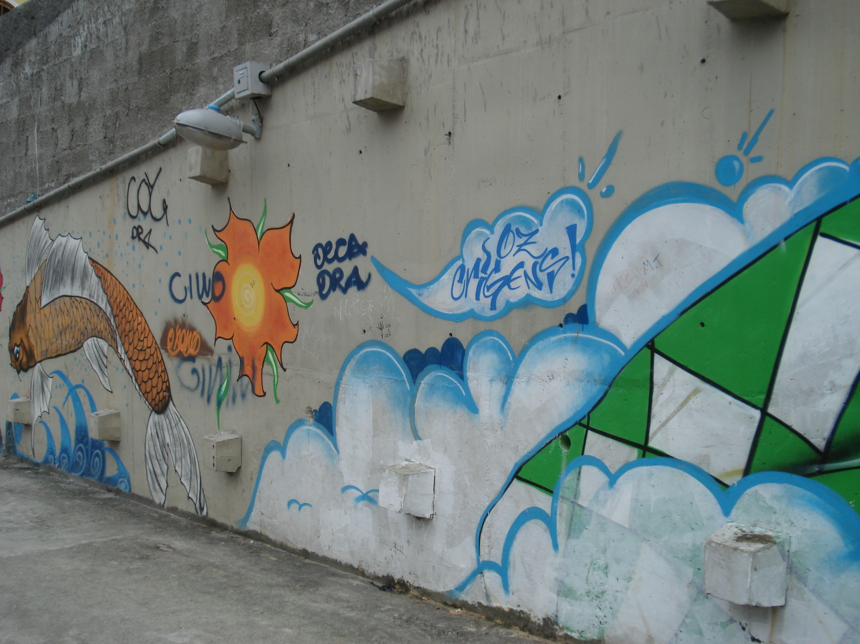

Slide 20
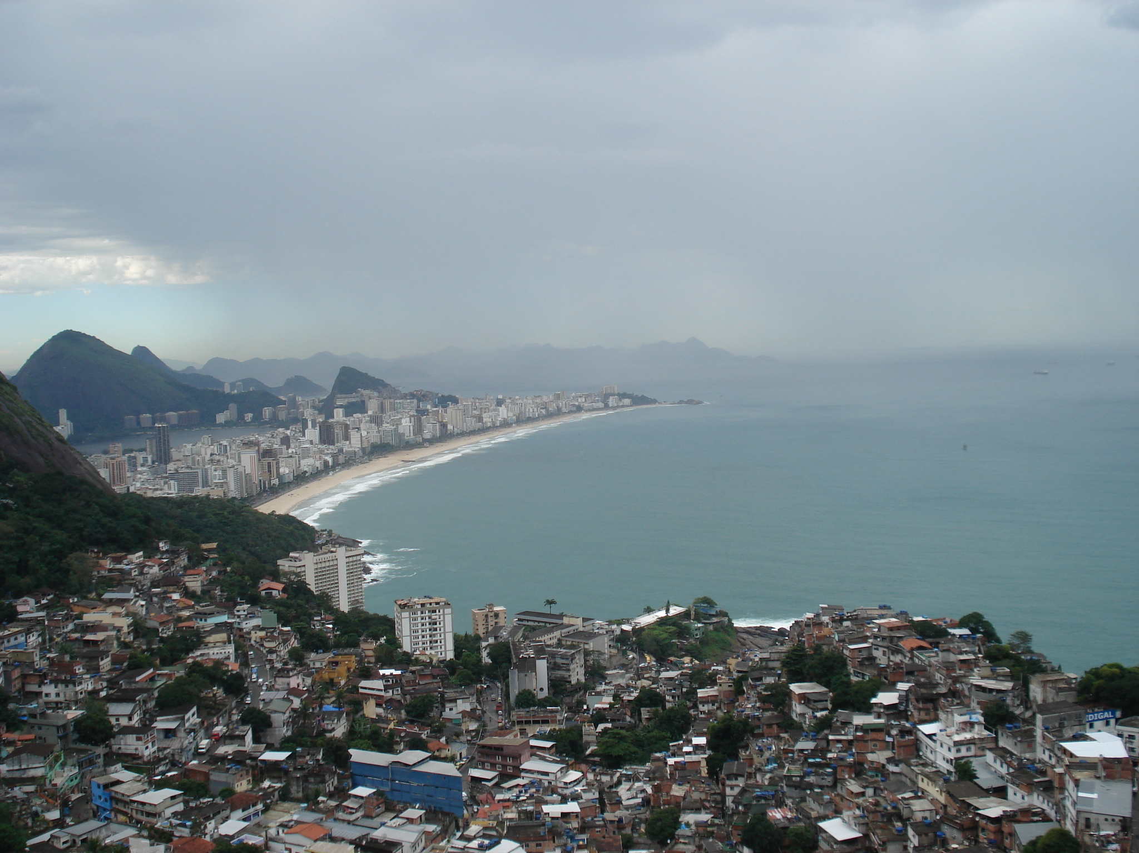

Slide 21
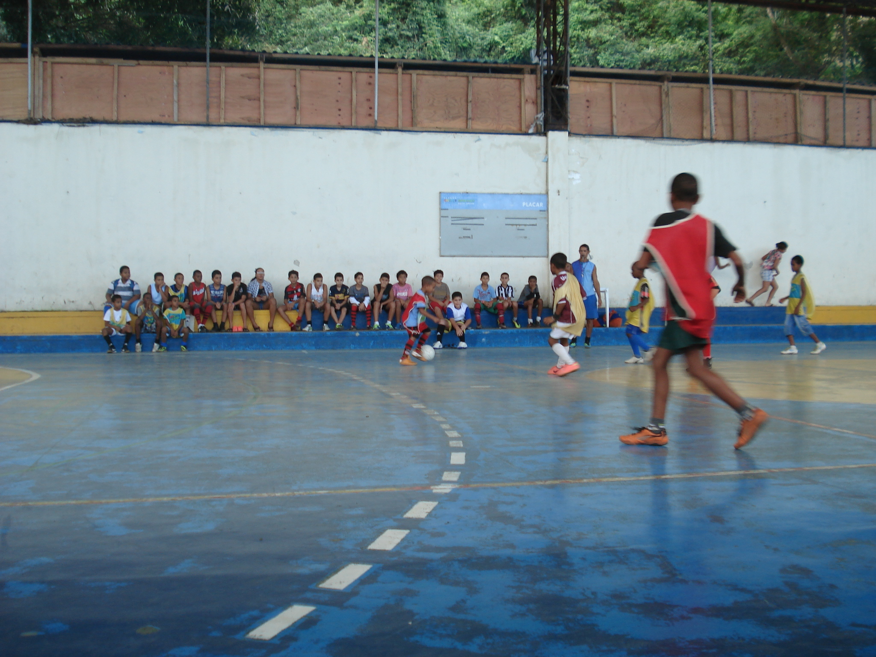

Slide 22
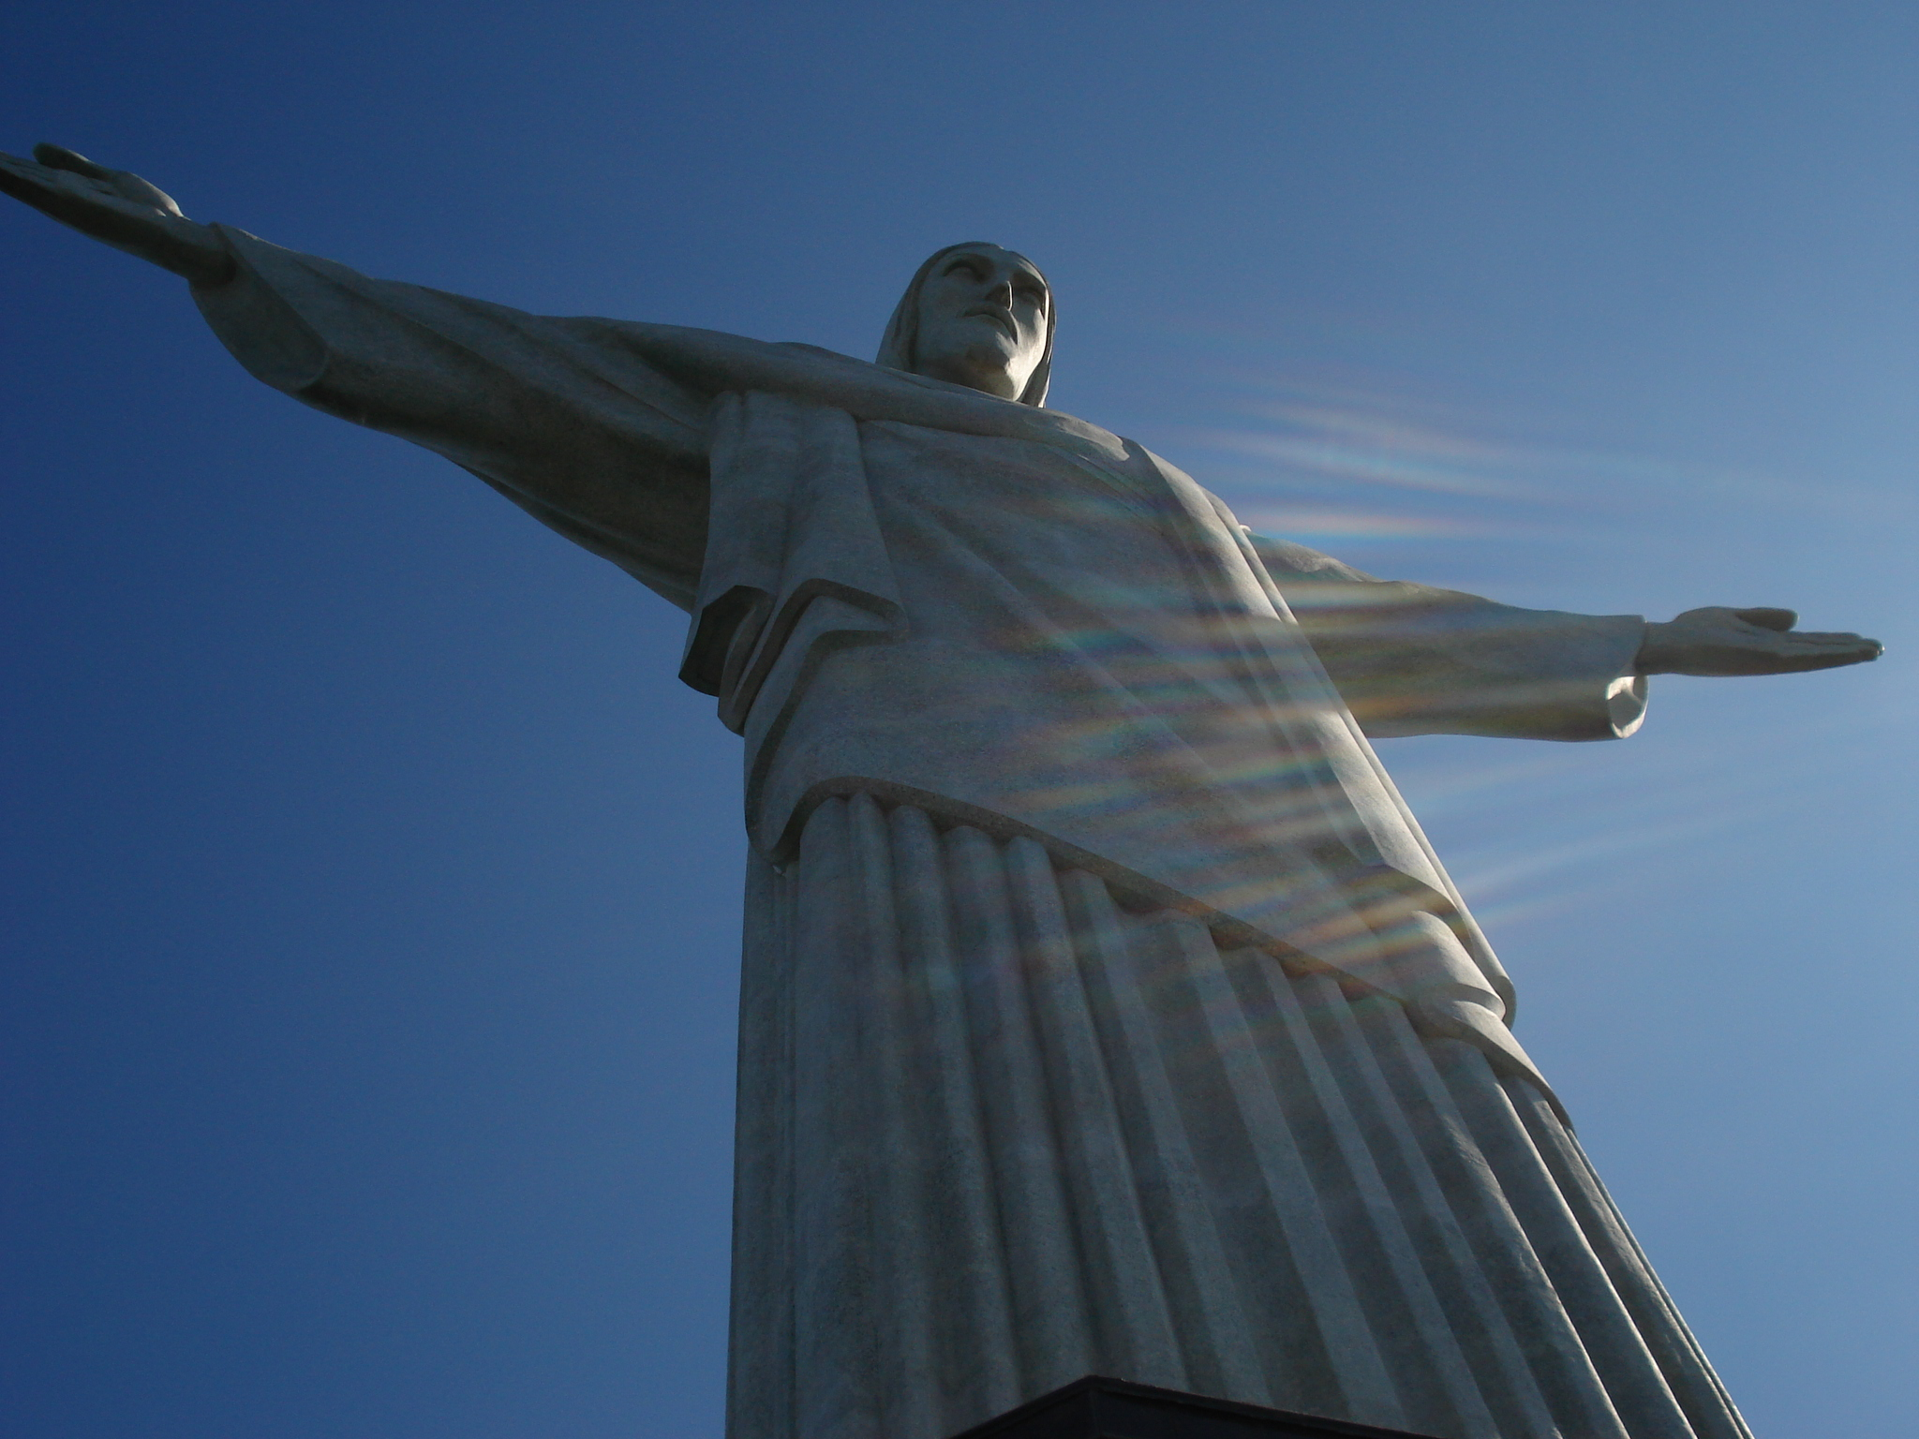

Slide 23
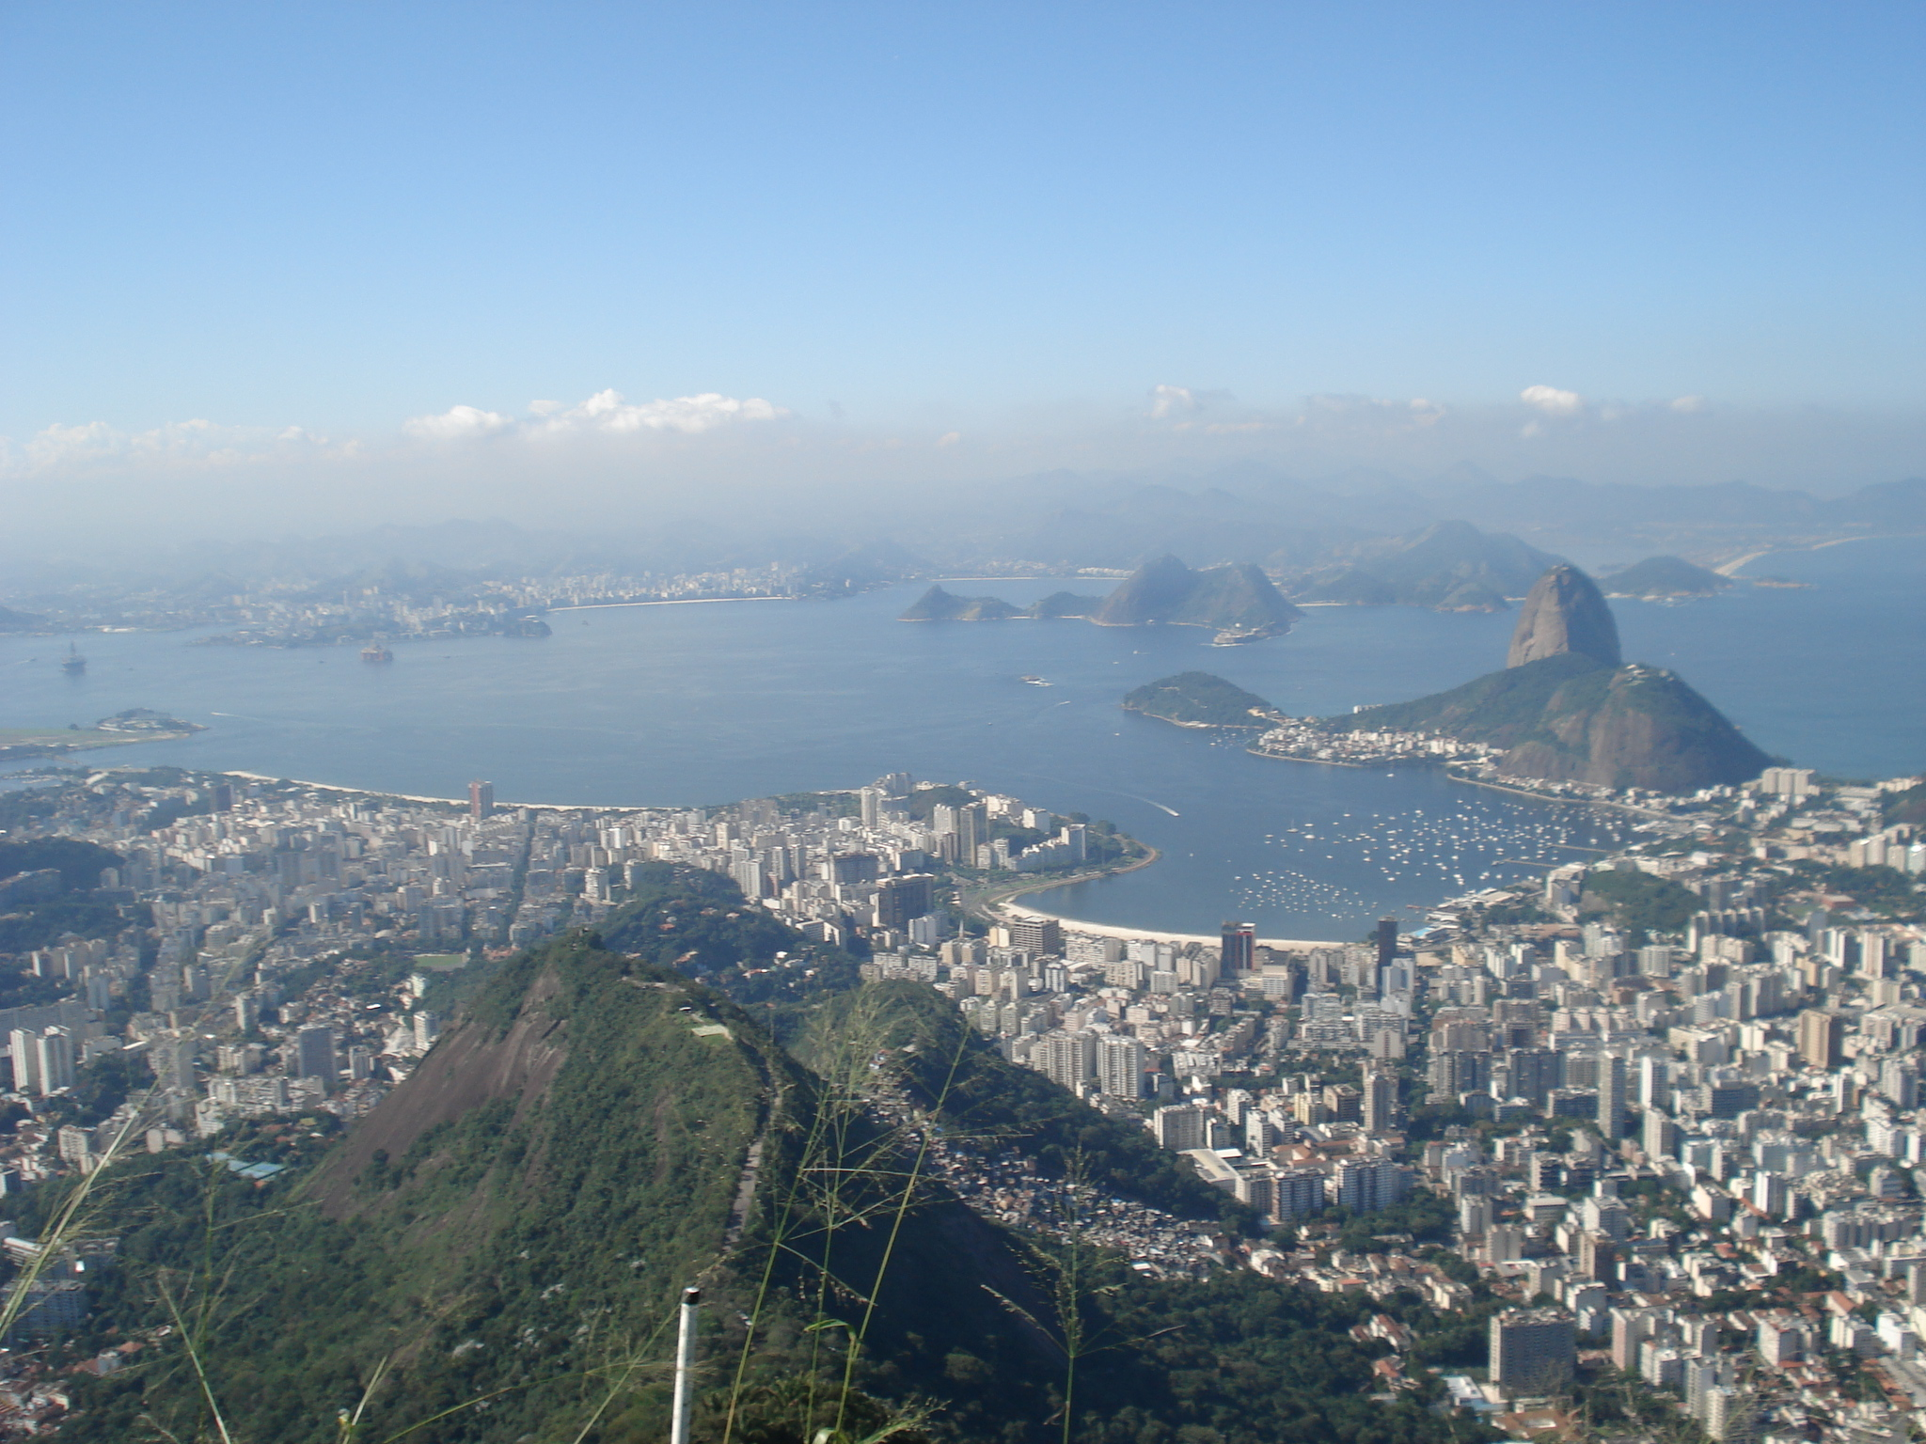

Slide 24
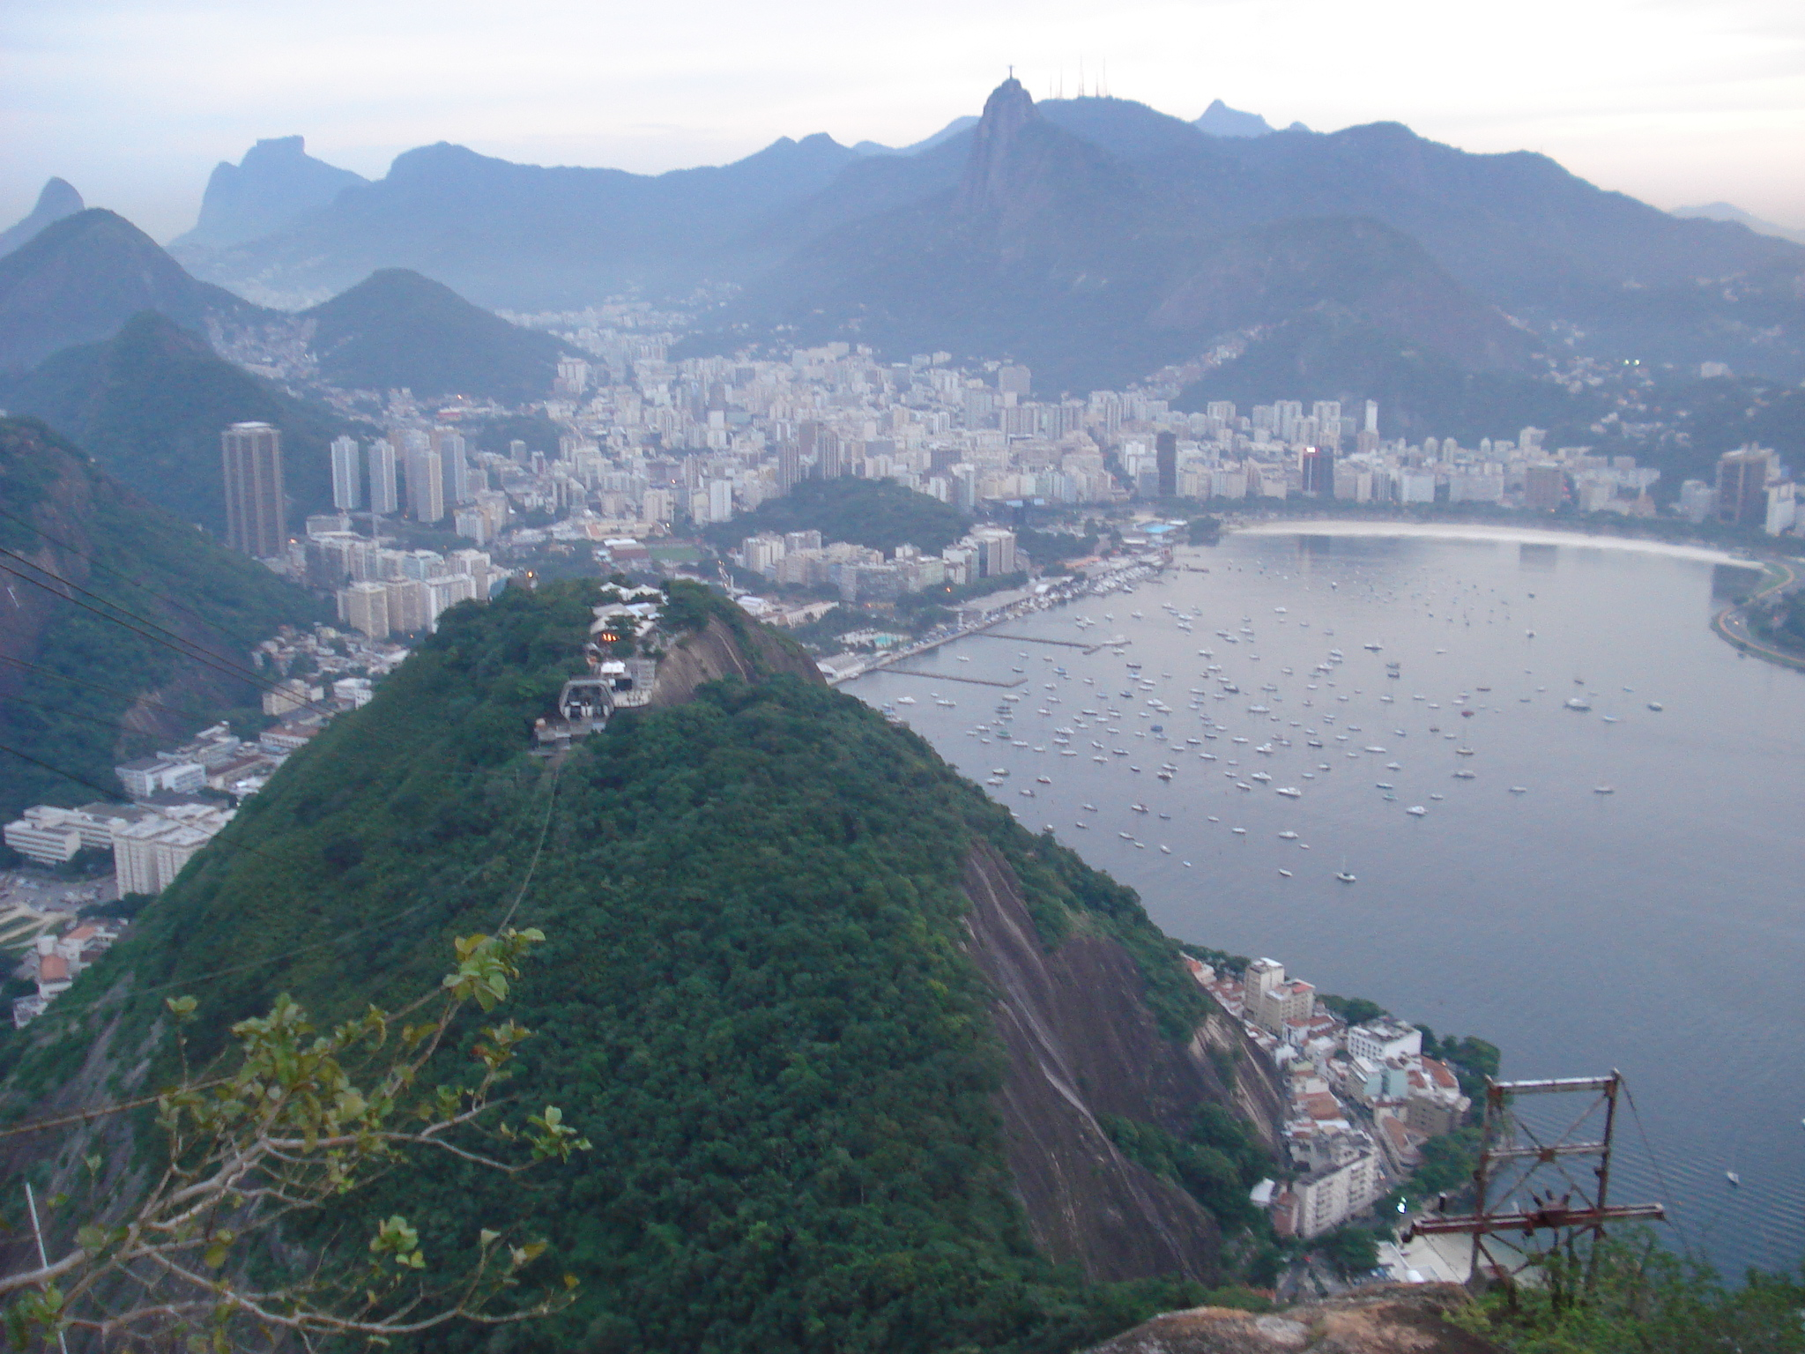

Slide 25
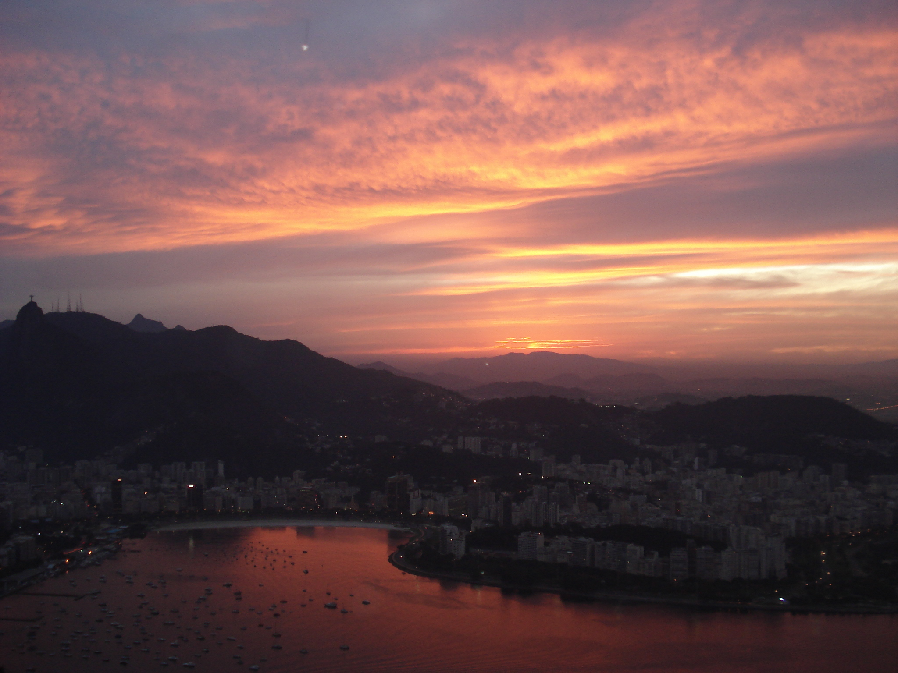

Slide 26
